Slide 1


KSAC Quarterly Meeting 08-28-2025

Slide 2
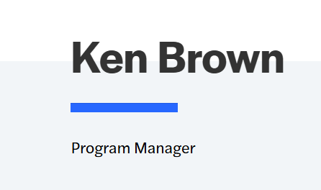
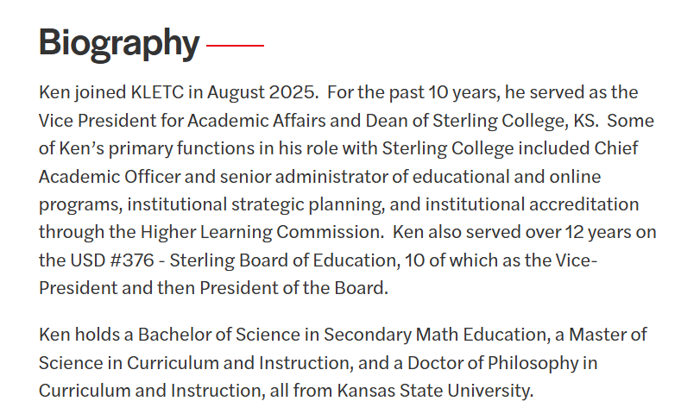
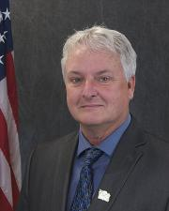


New Program Manager

Slide 3

New KLEAP Agency Spotlight
NEW AGENCIES – since last meeting:
Topeka Police Department (Dual Accredited) 06-10-2025
Gardner Police Department 08-01-2025
Medicine Lodge Police Department 08-05-2025
Barber County Sheriff’s Office 08-21-2025

Slide 4
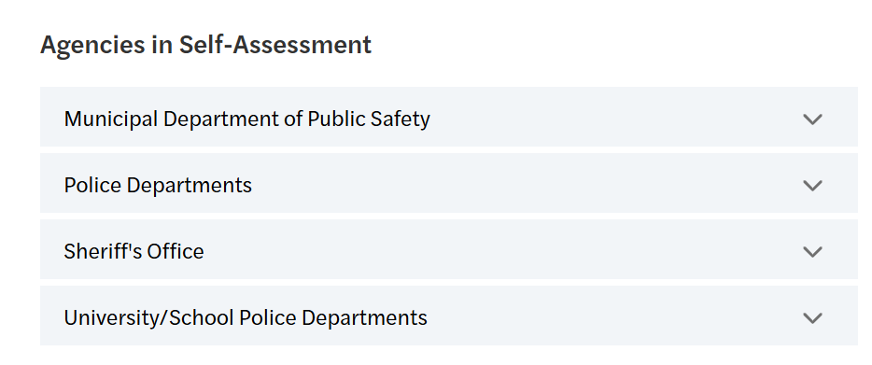

Agency Status
Agency Status:
  62 Agencies currently participating.

Slide 5

Mocks
MOCK Assessments:
St. Marys Police Department – ongoing
Olathe Police Department – June 2025 Completed
Hutchinson Police Department – August/September 2025
Parsons Police Department – September 2025
Abilene Police Department – August 2025
Augusta Department of Public Safety – August 2025 Completed
University of Kansas Police Department – August/September 2025
I need to know who conducted your mock and what files they reviewed?

Slide 6



On-Site Assessments
Agencies in Assessment:
Olathe Police Department Official Start Date: 01-26-2024
  Remote File Review: July 21st – August 30th, 2025 - Completed
  On-Site Visit: September 10th – 11th, 2025
Agencies in
Assessment

Slide 7
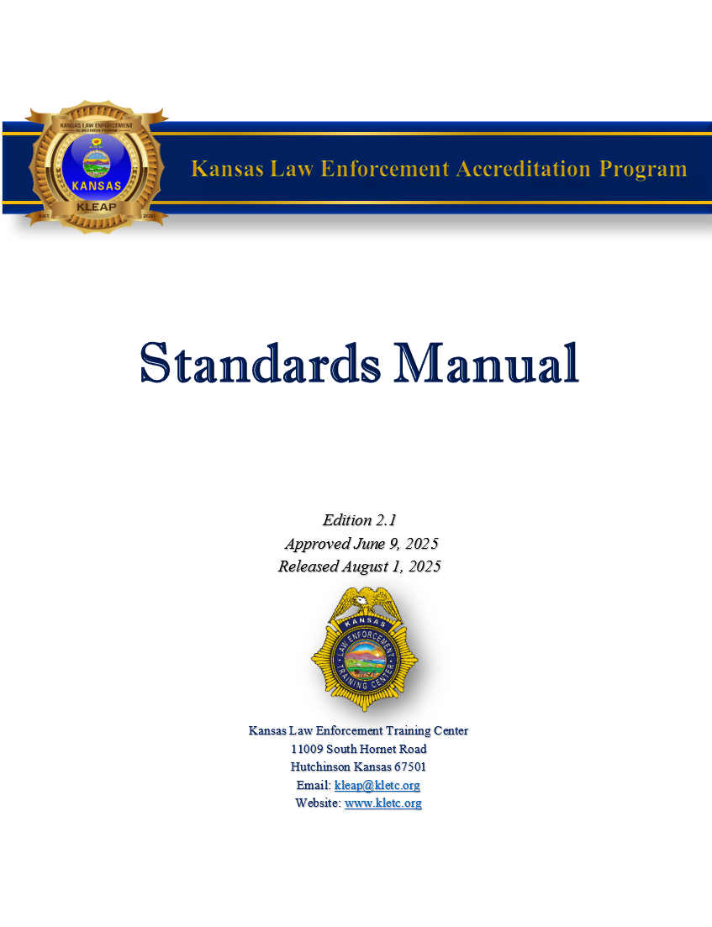
Program Updates
Updated Standards:
Edition 2.1 – Released 08-01-2025
Updates were prompted with the rescinding of Executive Order (EO) 14074 by President Trump. The KAC reviewed all applicable KLEAP Standards related directly to EO 14074. No KLEAP Standards were deleted; however, several were revised to omit required EO language.
If you started self-assessment in Edition 1, you will not switch to Edition 2.1 until after your on-site. Any agency who started self-assessment in Edition 2 will need to have their written directives in compliance with Edition 2.1 Standards by August 2026.

Slide 8
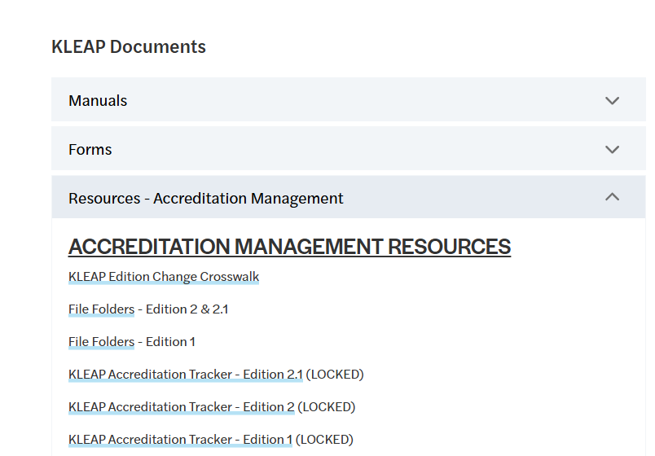
Program Updates – Standard Updates
Standard Changes:
KLEAP Edition Change Crosswalk
Available on the KLEAP Website

Slide 9
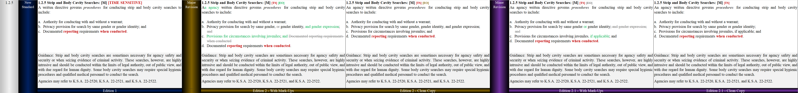
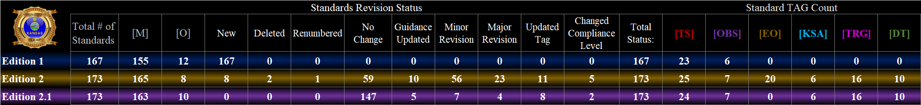
Resources – KLEAP Crosswalk
KLEAP Edition Change Crosswalk:
Provides the revision history for each KLEAP Standard

Slide 10
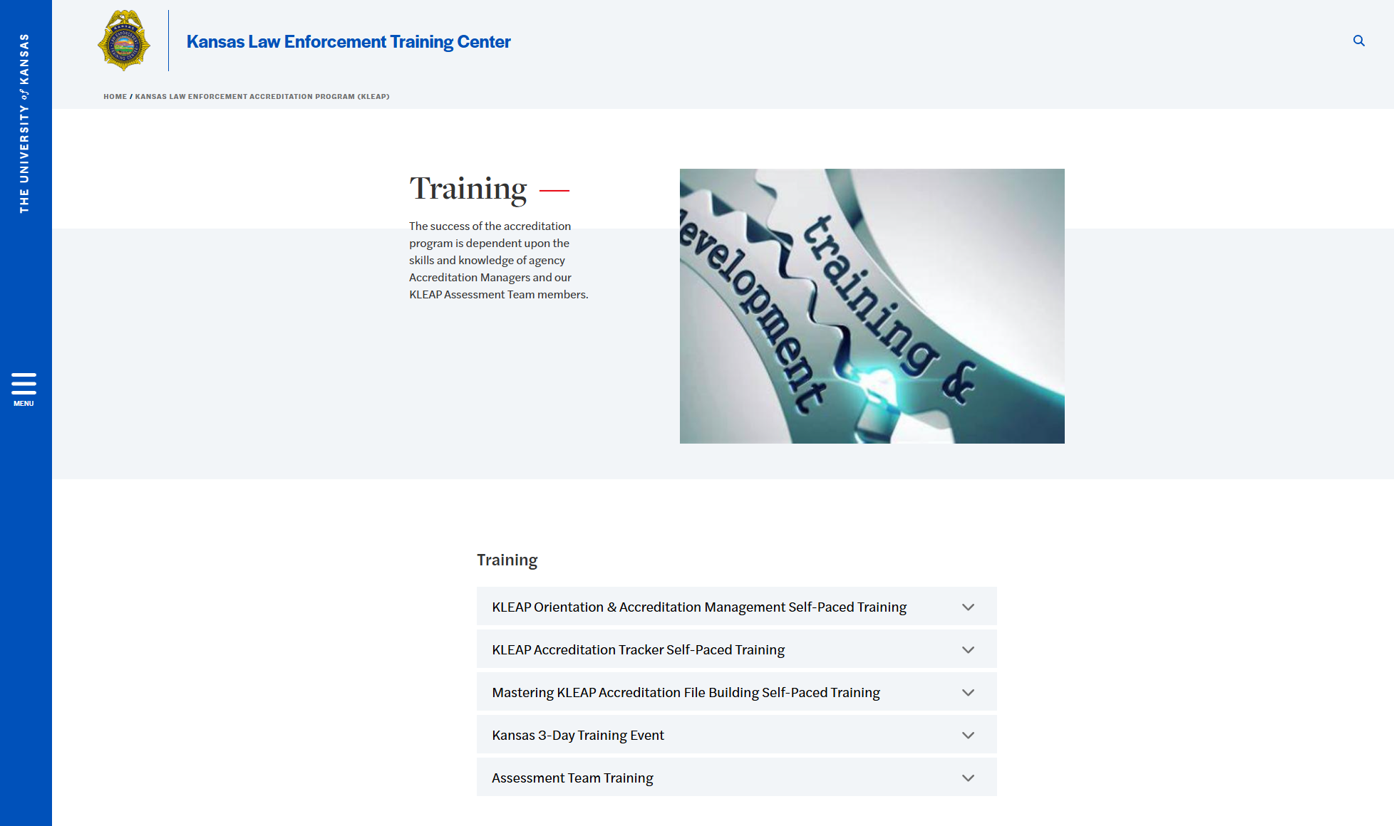
Resources – New Self-Paced Training
Self-paced learning is a style utilized by KLEAP as a method of instruction in which learners progress through the material provided at their own speed and on their own schedule.
With self-paced learning, learners are able to spend longer periods of time engaging with particular mini modules. This enables a more personalized approach in which the learner can determine their own unique needs and also allows for learners to reference back to mini-modules when needed.

Slide 11


Resources – Accreditation Orientation & Management Self-Paced Training
Accreditation Orientation & Accreditation Management Self-Paced Training
Accreditation Orientation
KLEAP History
Why Pursue KLEAP Accreditation
Accreditation Management Training
The Kansas Accreditation Council
Policy Management and Development
A Review of the KLEAP Standards
Best Practices
KLEAP Process Step 1: Submit a Participation Agreement
KLEAP Process Step 2: Self-Assessment
KLEAP Process Step 3: Mock Assessment
KLEAP Process Step 4: On-Site Assessment
KLEAP Process Step 5: Council Review
KLEAP Process Step 6: Reaccreditation

Slide 12

Resources – KLEAP Accreditation Tracker Self-Paced Training
KLEAP Accreditation Tracker Self-Paced Training
Getting Started
KLEAP Accreditation Tracker Overview
Resetting the Accreditation Tracker Password
Tab Features & Functionality Described
Customize Trackers Tab
Checklist & Timeline Tab
Written Directive Tracker Tab
Proof Trackers Tab
Report Trackers Tab
Training Log Tab
File Construction Tracker Tab
Dashboard Tab
Data Tables Tab
HELP Topics
Adding New Rows to Trackers

Slide 13

Resources – KLEAP Accreditation File Building Self-Paced Training
Mastering KLEAP Accreditation File Building Self-Paced Training
Getting Started With Adobe
Overview of Adobe Toolbars
Customize the Floating Quick Tools Panel
Combine Documents to Build Your Accreditation File
Move, Rotate, and Delete Pages.
Customize the Rectangle Shape to Yellow
Redacting Documents
Adding Written Directives to the Accreditation File
Highlighting WDs
Double Highlighting WDs
Labeling WDs
Tagging WDs
Handling Text on Split Pages
Sorting Comments by Author
Consistency with WDs
Continued…..

Slide 14
Resources – KLEAP Accreditation File Building 2 Self-Paced Training
Mastering KLEAP Accreditation File Building Self-Paced Training
Adding Proofs to the Accreditation File
Highlighting PFs
Labeling PFs
Tagging PFs
Handling Multiple Page PFs
Consistency with PFs
Adding Notes to the Accreditation File
N/A By Function Notes
No Occurrence Notes
Interviews with SME Notes
Handling Remote File Review
Remote File Review Procedures
Help & Troubleshooting
Printing K.S.A.’s to PDF
Removing Gridlines

Slide 15
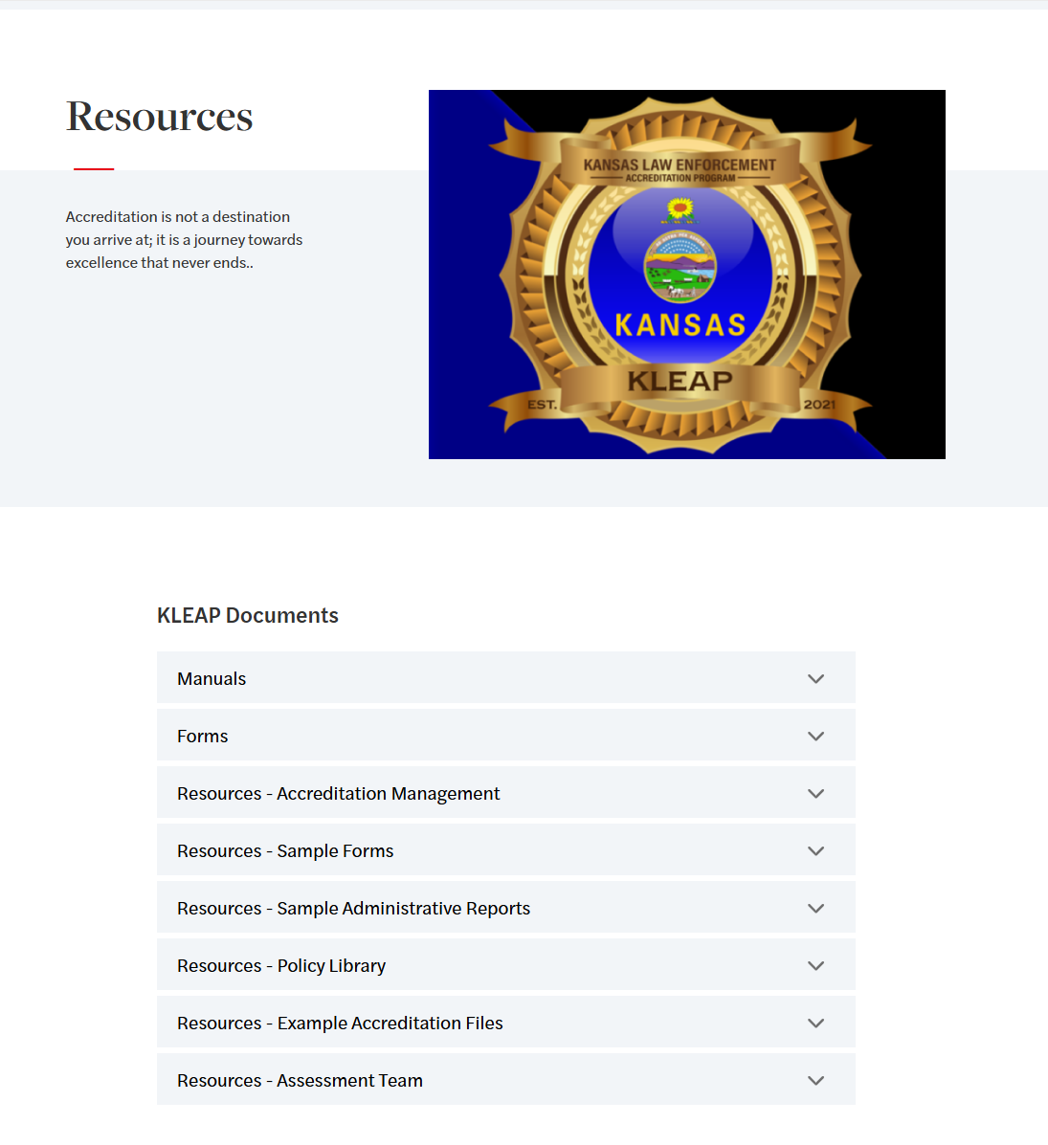
KLEAP Update – Grant Projects
Grant Projects
Additional Resources
Coming Soon
Anticipated Release Date: Sept. 2025
Anticipated Release Date: Sept. 2026
Anticipated Release Date: Mar. 2026
Anticipated Release Date: Dec. 2025

Slide 16


Save the Date
3-Day Training Conference
March 9^{th -}11th, 2026
University of Kansas Edwards Campus
12600 Quivira Road
Overland Park, KS 66213

Slide 17



Volunteers Needed
3-Day Conference Committee Volunteers Needed!
Which committee can you help with?
1. Instructors 2. Registration 3. Hospitality
Email Training Topics you want to see offered to:
Kleap@kletc.org

Slide 18


Questions
QUESTIONS
?

