Slide 1


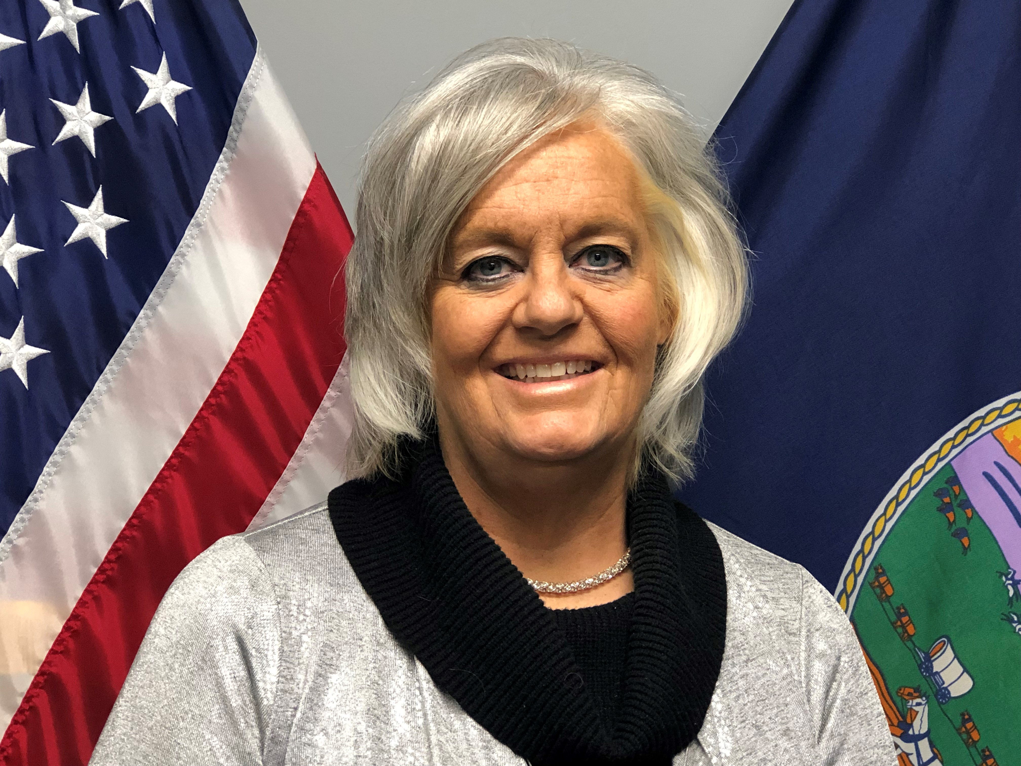

Meeting
09-07-2023

Slide 2


Program Manager Update
Since our last quarterly meeting I have visited the following agencies:
  06-26-2023 Wyandotte Sheriff’s Office
  07-25-2023 Arkansas City Police Department
  07-26-2023 Wichita Police Department
  08-01-2023 Wellington Police Department (Pending Sign Up)
  08-03-2023 Valley Center Department of Public Safety
  08-08-2023 Dickinson County Sheriff’s Office
  08-09-2023 Abilene Police Department
  08-16-2023 St. Mary’s Police Department
  08-25-2023 Marshall County Sheriff’s Office
  09-05-2023 Emporia Police Department
Kansas Law Enforcement Accreditation

Slide 3
Program Manager Update
Upcoming visits schedule include:
  09-08-2023 Topeka Public Schools Police Department
  09-26-2023 Leavenworth County Sheriff’s Office
  09-28-2023 Lyndon Police Department
  10-03-2023 Spring Hill Police Department
  10-12-2023 Merriam Police Department
  10-18-2023 Baxter Springs Police Department
  10-19-2023 Cherokee County Sheriff’s Office
  10-26-2023 Parsons Police Department
  11-16-2023 Wellsville Police Department
  11-21-2023 Osage City Police Department
Kansas Law Enforcement Accreditation

Slide 4

Program Manager Update
National Standards for Independent Credentialing Bodies
[Executive Order 14074 – Section 19] – Received 05/24/2023
  I will be back briefing the Kansas Accreditation Council (KAC) at our 2nd Quarter Meeting scheduled for June 22nd.
  As our agenda is already very heavy for this meeting, I will propose a “special meeting” be held to approve Standard revisions needed for compliance with EO 14074.
  EO 14074 has 20 Required Standards and 24 Optional Standards
  Standards required by EO 14074 will be distinguishable in the 2nd Edition.
  Once the 2nd Edition is released, I will post EO 14074 to the KLEAP Website.
Kansas Law Enforcement Accreditation

Slide 5
Winter Projects (Dec. – Mar.)
File Construction Development Guide
  Identify standards elements.
  Provide suggestions for proofs and how many needed per accreditation cycle.
Vehicle Pursuit Incident Tracker - Analysis Report
Expand the KS Use of Force Report Incident Tracker – Analysis Report
Update Assessor Curriculum class (May 2024)
Policy Library
Kansas Law Enforcement Accreditation

Slide 6
KLEAP Website Legal Disclaimer
LEGAL DISCLAIMER
The Kansas Law Enforcement Accreditation Program (KLEAP) is a program of the Kansas Law Enforcement Training Center (KLETC) designed to function as an independent accrediting entity under the direction of the Kansas Accreditation Council (KAC) to serve Kansas law enforcement agencies. KLEAP Leadership does not endorse, has not entered into a partnership agreement, or contracted with any private vendor selling software to help agencies facilitate their KLEAP process. Agencies wishing to utilize software from a private vendor to manage their accreditation process should be advised that KLEAP Leadership does not certify, vet, or approve any vendor software to ensure it will meet KLEAP compliance.
Kansas Law Enforcement Accreditation

Slide 7
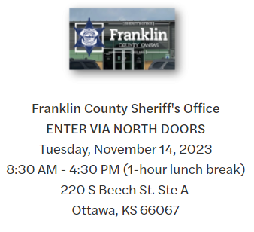
Program Manager Update
Enrollment:
  48 Agencies enrolled, 38 Interested.
Training:
  Last opportunity in 2023 to attend
  Accreditation Manager Training
Kansas Law Enforcement Accreditation

