Slide 1
Meeting 11-30-2023

Slide 2
Program Manager Update
Updates:
55 Agencies enrolled, 40 Interested.
38 Agency visits conducted in 2023.
11 Agency have stated they will be ready for their on-site in 2024!
Kansas Law Enforcement Accreditation

Slide 3
Program Manager Update
NEW AGENCIES
Linn County Sheriff’s Office [AM Vin Inspector Doug Barlet]
Hays Police Department [AM Lt. Tim Greenwood]
WaKeeney Police Department [AM Ofc. Earnest O’Banion]
Johnson County Sheriff’s Office [Capt. Douglas Wade]
Bel Aire Police Department [Lt. Robey Foxx]
Yates Center Police Department [Asst. Chief Vinson C. Baker]
El Dorado Police Department [AM Deputy Chief Jeff Murphy]
Kansas Law Enforcement Accreditation

Slide 4
Agency Sharing
Thank you Leavenworth CO SO!
GunBusters | Firearm Destruction Experts (gunbustersusa.com)
GunBusters provides free firearms destruction for law enforcement agencies.
GunBusters is the industry leader for firearms destruction. We provide a SAFE, SIMPLE and SECURE firearms destruction program FREE OF CHARGE for law enforcement agencies. Our patented process includes a video package allowing the agency to verify the actual destruction of each individual firearm.
On-Site Pickup The GunBusters team will pick up the firearms from your agency and do an on-site audit to verify serial numbers. This process ensures accuracy through every step of the process.
Destruction Firearms are processed through the GunBusters Firearms Pulverizer. Each firearm is destroyed individually. Our destruction process exceeds ATF requirements for firearm destruction.
Documented The entire destruction process is video recorded to ensure proof of destruction. These destruction videos are provided to the department and are searchable by serial number and agency case number.
Kansas Law Enforcement Accreditation

Slide 5
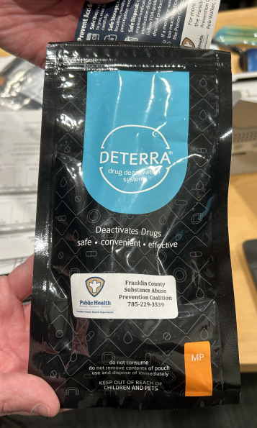
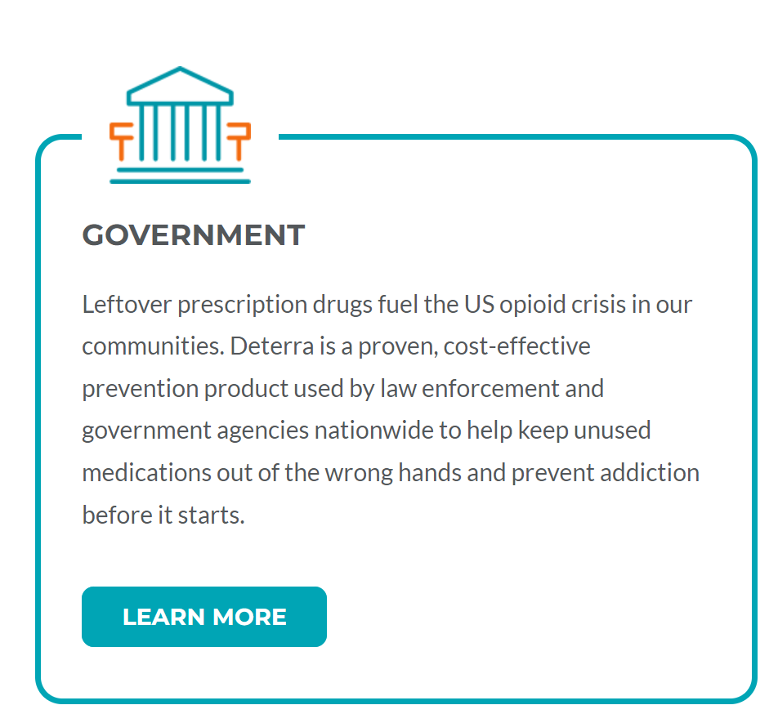
Agency Sharing
Thank you Wellsville Police Department!
Deterra® Drug Deactivation System)
DETERRA IS THE SOLUTION FOR SAFE MEDICATION DISPOSAL
Deterra is on a mission to prevent drug misuse and protect our environment through safe, permanent disposal of unused prescription and over the counter medications. The Deterra Drug Deactivation and Disposal System is the only product that is independently tested and scientifically proven to destroy drugs for good. Our patented, easy-to-use drug disposal system can be used at home or in a clinical setting to safely destroy unused or expired medications, making them unavailable for misuse and safe for disposal in the normal trash.
Kansas Law Enforcement Accreditation

Slide 6
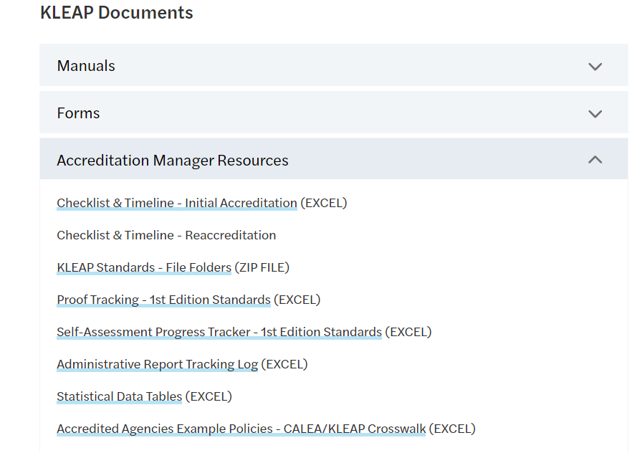
NEW KLEAP Resource
Now available on the kleap website
Manuals, Forms, and Resources / Accreditation Manager Resources
Kansas Law Enforcement Accreditation

Slide 7
Program Manager Update
2024 Assessor Training
Dates: Wednesday, May 29th and Thursday, May 30th
Times: 0800 – 1700 hrs.
Location: Leavenworth County Sheriff’s Office
Applications being accepted now!
Limited spaces available!
Participates are selected based on qualifications!
We will be conducting a “real” mock assessment for LCSO.
Previously trained KLEAP assessor are encouraged to attend to assist with the training class and get on-the-job training.
Kansas Law Enforcement Accreditation

Slide 8
Program Manager Update
Enhanced Accreditation Manager Training
The following agencies attended the 1st Enhanced Accreditation Manager Training on 11-17-2023 at the Franklin CO SO.
Abilene Police Department (2)
Augusta Department of Public Safety (1)
Cherokee County Sheriff’s Office (1)
El Dorado Police Department (1)
Emporia Police Department (3)
Gardner Police Department (1) Sign up pending
Hutchinson Police Department (1)
Johnson County Sheriff’s Office (2)
Linn County Sheriff’s Office (1)
McPherson Police Department (1)
Osage City Police Department (1)
Osage County Sheriff’s Office (1)
Park City Police Department (1) Sign up pending
Spring Hill Police Department (2)
Valley Center Department of Public Safety (1)
WaKeeney Police Department (3)
Yates Center Police Department (2)
Coming 1st Quarter 2024
Enhanced Accreditation Manager Training On-Line Learning
Kansas Law Enforcement Accreditation

Slide 9
Program Manager Update
File Construction On-Line Learning
Coming 1st Quarter 2024
This training will be taught in 2-hour sessions conducted over 4 consecutive weeks for a total of 8-hours of training.
Kansas Law Enforcement Accreditation

Slide 10
Program Manager Update
Coming early 2024
File Construction Guidance Tracker
The proof tracker has been extremely helpful especially with having no accreditation experience. When I have the time I use it extensively and have use it to make lists for certain positions/officers based on their roles here. I would assume that during the reaccreditation cycle how you have them designated by which ones for which year will also help out immensely. Thank you for putting this together and letting me be a guinea pig for it!
Sergeant Nick Weiler
Merriam Police Department
Kansas Law Enforcement Accreditation

