Slide 1


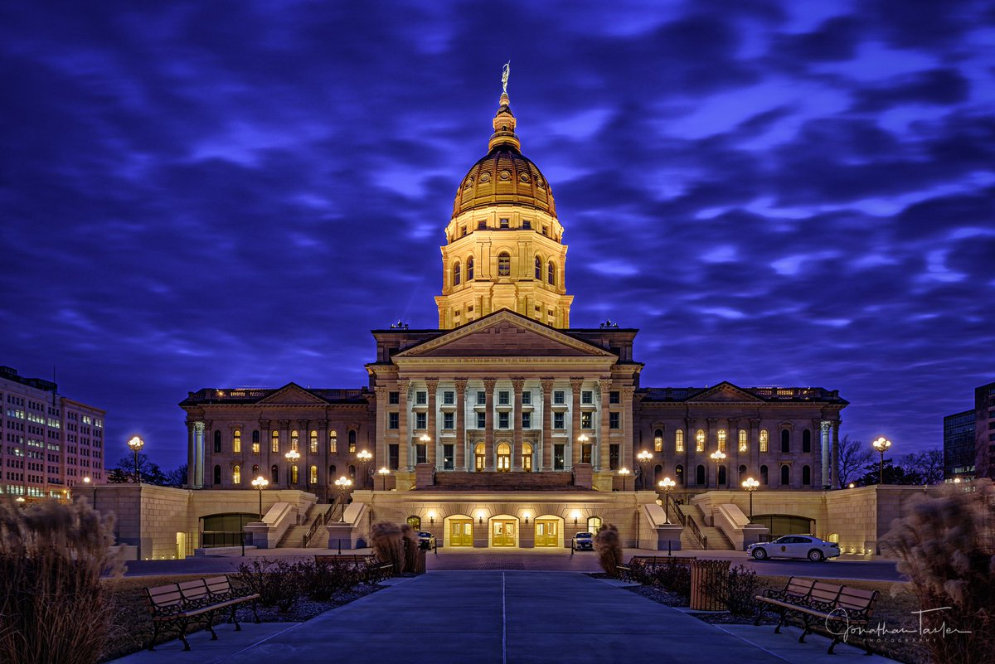
Meeting
06-01-2023

Slide 2


Program Manager Update
I am working remotely, effect 05/27/2023 my home base will be Lansing, KS. The goal is to be on the road spending more face-to-face time with agencies.
My desk phone rings to my cell phone so you can reach me by calling either one.
Kansas Law Enforcement Accreditation

Slide 3
Program Manager Update
National Standards for Independent Credentialing Bodies
[Executive Order 14074 – Section 19] – Received 05/24/2023
  I will be back briefing the Kansas Accreditation Council (KAC) at our 2nd Quarter Meeting scheduled for June 22nd.
  As our agenda is already very heavy for this meeting, I will propose a “special meeting” be held to approve Standard revisions needed for compliance with EO 14074.
  EO 14074 has 20 Required Standards and 24 Optional Standards
  Standards required by EO 14074 will be distinguishable in the 2nd Edition.
  Once the 2nd Edition is released, I will post EO 14074 to the KLEAP Website.
Kansas Law Enforcement Accreditation

Slide 4
Program Manager Update
Changes to Standards in 2nd Edition will be available in
Addendum H – Transition Policy
  Upon approval of Standard revisions agencies will have 1-year “Transition Period” to become compliant with revised or new standards.
  To accommodate agencies having an accreditation on-site assessment during the transition period, KLEAP allows the option of complying with either Standard Manual Edition.
  Agencies may NOT interchange standards from one edition to another.
  Agencies MUST notify the Program Manager of their Edition choice at least 90-days prior to their scheduled assessment.
  All new agencies signing their Agency Participation Agreement on or after the date of a new manual edition being published will be required to use the new edition exclusively.
  The KAC is authorized to grant exceptions and/or extensions to this transition policy on a case-by-case basis.
Kansas Law Enforcement Accreditation

Slide 5

KLETC/KLEAP is apply for two additional grants:
FY23 Enhancing Existing Law Enforcement Accreditation Entities - Community Policing Development – KU Missed the filing deadline
FY23 Supporting Law Enforcement Agencies in Seeking Accreditation - Community Policing Development
I am currently helping:
    Chief David Porter, DeWitt Police Department (Iowa)
    Jeff Potts Executive Director Chiefs of Police Association (Minnesota)
Kansas Law Enforcement Accreditation

Slide 6
Program Manager Update
KLEAP Service Enhancements
Program Orientation Video to KLEAP Website - Accomplished
Report & Forms Library on Website – Pending
Interactive databases for high liability Annual Analysis reporting – In process
On-site Facility Inspection for newly enrolled agencies – Accomplished
On-site visit to assist AM getting started in self-assessment – In process
Policy Library on Website – Pending
Mid-Year status checks to gage agency progress – Pending
New Training – Conducting Mock Assessments – Think Like An Assessor - Pending
Proof of Compliance Matrix – Pending
Consultation Appointments - Pending
Kansas Law Enforcement Accreditation

Slide 7
Program Manager Update
KLEAP Service Enhancements
  Use of Force Database
    The program utilizes the State Use of Force Reporting form
    It can hold up to 100 Use of Force Reports
    It will auto write your Annual Use of Force Analysis
    It allows for an Administrative Review of each report
    If your agency does not already have software in place and would like to see a demo/training please contact me.
Kansas Law Enforcement Accreditation

Slide 8
Program Manager Update
KLEAP Service Enhancements
  On-site Facility Inspection – Checking 59 compliance areas.
Completed:
  04/17/2023 – Larned Police Department
  04/18/2023 – Dodge City Police Department
  04/19/2023 – Goodland Police Department
  04/20/2023 – Scott City Police Department
  05/16/2023 – El Dorado Police Department
Upcoming:
  08/08/2023 – Abilene Police Department
  08/09/2023 – Dickinson County Sheriff’s Office
If you feel this would benefit your agency reach out to me to schedule your visit!
Kansas Law Enforcement Accreditation

Slide 9
2nd Edition Standard Revision
Issue: Drug screening performed by a licensed physician.
4.1.2 Medical Examinations: [M]
The agency requires a medical examination for all sworn candidates, including a drug screening, to be performed by a licensed physician following a conditional offer of employment and before appointment to the position.
REVISED
The agency requires a medical examination for all sworn candidates, including a drug screening, to be performed by a licensed physician and a drug screening is conducted following a conditional offer of employment and before appointment to the position.
Kansas Law Enforcement Accreditation

Slide 10
2nd Edition Standard Revision
Issue: Not all agencies have them separated
20.1.1 Privacy and Security: [M]
A written directive establishes procedures for the privacy and security of agency records (hard copy and computerized), that includes at a minimum:
Physical separation, or a method to distinguish, of juvenile and adult arrest records;
Collection, dissemination, and retention of fingerprints, photographs, and other forms of identification pertaining to juveniles;
Physical security and controlled access to files; and
The release of records.
Kansas Law Enforcement Accreditation

Slide 11
2nd Edition Standard Revision
Issue: State UOF Report does not capture
6.2.3 Annual Analysis of Use of Force Reporting: [M] [TIME SENSITIVE]
The agency conducts an annual analysis of its use of force reports, completed in accordance with standard 6.2.1, and the agency policies and procedures. The annual analysis at a minimum should identify:
a. Date Day and time incident occurred;
b. Types of incidents resulting in the use of force;
c. Trends or patterns related to race, age, gender, crimes reason for contact, and location of
subjects involved;
d. Trends or patterns of injuries to any subjects or employees involved; and
e. Any influence of findings on policies, procedures, training, and equipment.
Kansas Law Enforcement Accreditation

Slide 12

Software Program Update
Standard references will be completed by August 2023
Kansas Law Enforcement Accreditation

Slide 13
Program Manager Update
Enrollment:
  41 Agencies enrolled, 45 Interested.
Training:
  FREE to Participating Agencies, non-participating agencies will be billed $50 per attendee.
  AM Training KLETC Hutchinson Classroom 8 – Thursday, July 13, 2023
  AM Training Franklin County Sheriff’s Office – Tuesday, July 18, 2023
Kansas Law Enforcement Accreditation

Slide 14

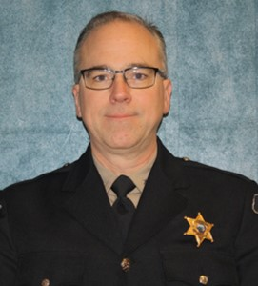
Assessor
Prospective Agencies
Bonner Springs Police Department
Colby Police Department
Derby Police Department
El Dorado Police Department
Ellinwood Police Department
Ellsworth County Sheriff’s Office
Ellsworth Police Department
Finney County Sheriff’s Office
Frontenac Police Department
Garden City Police Department
Gardner Police Department
Graham County Sheriff’s Office
Gray County Sheriff’s Office
Haven Police Department
Hays Police Department
Haysville Police Department
Horton Police Department
Hugoton Police Department
Humboldt Police Department
Independence Police Department
Jackson County Sheriff’s Office
Johnson County Sheriff’s Office
Junction City Police Department
Kansas City KS Public Schools PD
Kearney County Sheriff’s Office
Lenexa Police Department
Linn County Sheriff’s Office
Louisburg Police Department
Minneapolis Police Department
Montgomery County Sheriff’s Office
Nemaha County Sheriff’s Office
Norton Police Department
Olathe Police Department
Osage City Police Department
Overland Park Police Department
Prairie Village Police Department
Rose Hill Police Department
Russell Police Department
Sedgwick County Courthouse Police
Shawnee Police Department
Spring Hill Police Department
Wathena Police Department
Wellington Police Department
Wellsville Police Department
Wichita State University Police Dept.
Kansas Law Enforcement Accreditation
Eric Green

Slide 15
Program Manager Update
KACP Booth 05-02-2023:
  13 KLEAP Participating Agencies stopped by
  15 Non-participating agencies stopped by to learn more
KLEAP Activities:
  March 6th & 7th – Conducted 2-Day Assessor Certification Class – 26 attendees
    13 Lead Assessors
    3 Assessors
Kansas Law Enforcement Accreditation

Slide 16
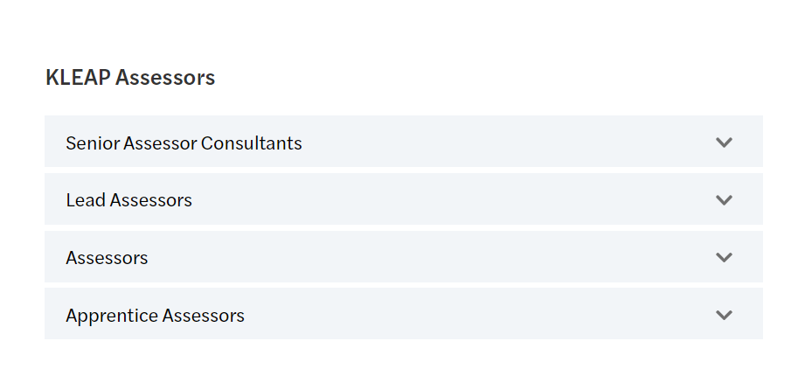
Assessor
KLEAP ASSESSORS
MOCK
RESOURCE
Kansas Law Enforcement Accreditation
Eric Green

