Slide 1
Meeting 09-05-2024

Slide 2
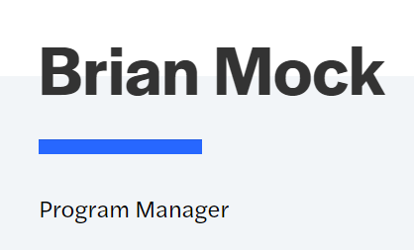
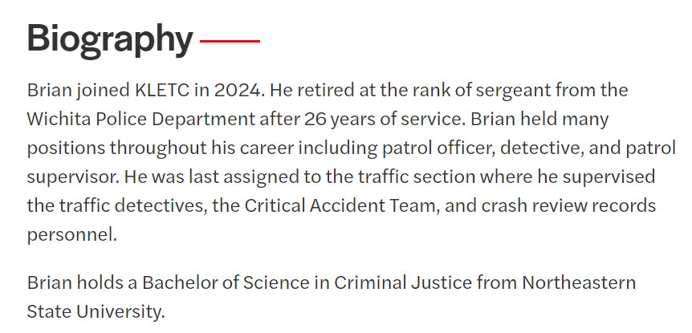
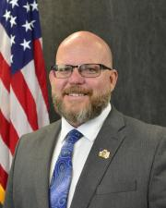
Program Updates
KLEAP Program Changes:
Kansas Law Enforcement Accreditation

Slide 3
Agenda – Action Items
NEW AGENCIES – since last meeting.
Valley Center Police Department – 07-01-2024
Auburn Police Department – 07-16-2024
Univ. of Kansas Medical Center PD – Dual Accredited – 07-30-2024
Kansas Law Enforcement Accreditation

Slide 4
Program Updates
Agency Status:
62 Agencies currently participating.
Kansas Law Enforcement Accreditation

Slide 5
Program Updates
39 Prospective Agencies:
Bonner Springs Police Department
Chase County Sheriff’s Office
Cherokee County Sheriff’s Office
Decator County Sheriff’s Office
Ellsworth County Sheriff’s Office
Ellsworth Police Department
Finney County Sheriff’s Office
Frontenac Police Department
Garden City Police Department
Gardner Police Department
Graham County Sheriff’s Office
Gray County Sheriff’s Office
Haven Police Department
Haysville Police Department
Horton Police Department
Humboldt Police Department
Independence Police Department
Jackson County Sheriff’s Office
Junction City Police Department
Kansas City KS Public Schools PD
Kearney County Sheriff’s Office
Lenexa Police Department
Louisburg Police Department
Miami County Sheriff’s Office
Minneapolis Police Department
Montgomery County Sheriff’s Office
Morton County Sheriff’s Office
Norton Police Department
Park City Police Department
Prairie Village Police Department
Roeland Park Police Department
Rose Hill Police Department
Russell Police Department
Sherman County Sheriff’s Office
Stevens County Sheriff’s Office
Wathena Police Department
Wichita State University Police Dept.
Winfield Police Department
Woodson County Sheriff’s Office
Kansas Law Enforcement Accreditation

Slide 6
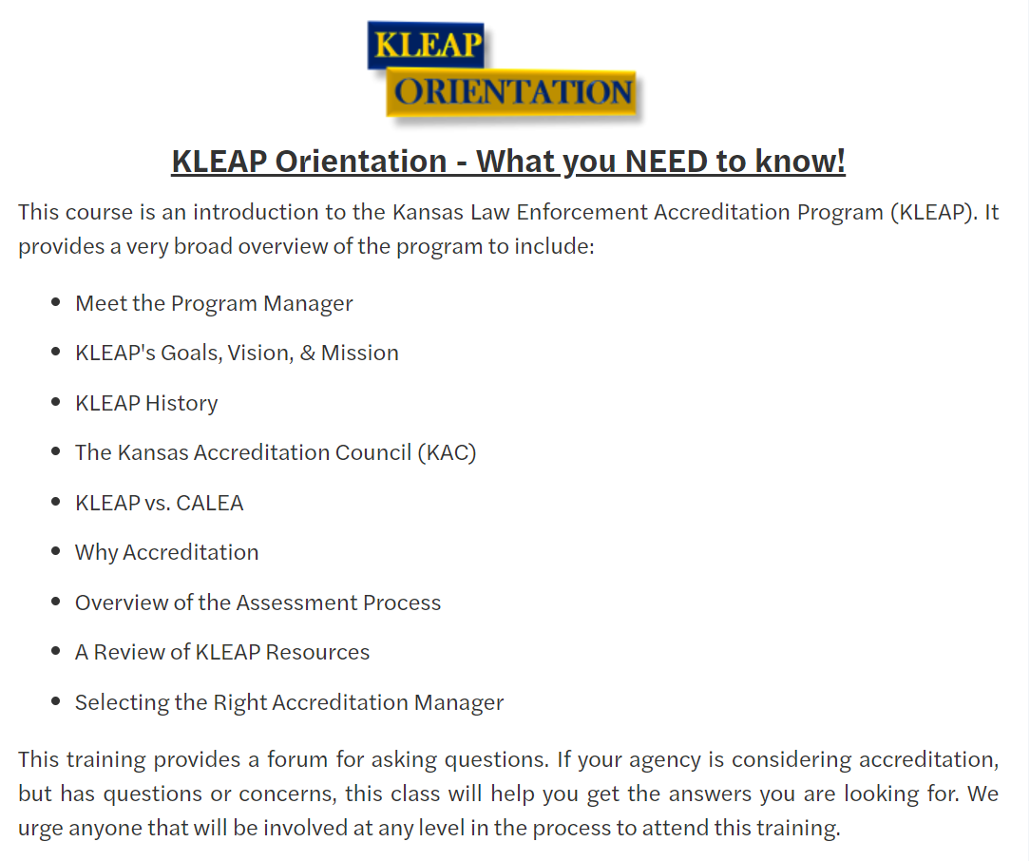
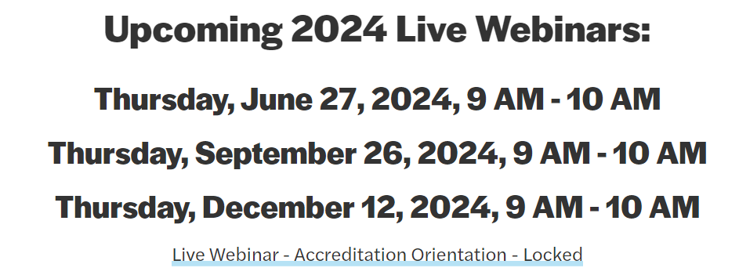
Program Updates
Training Update:

Slide 7
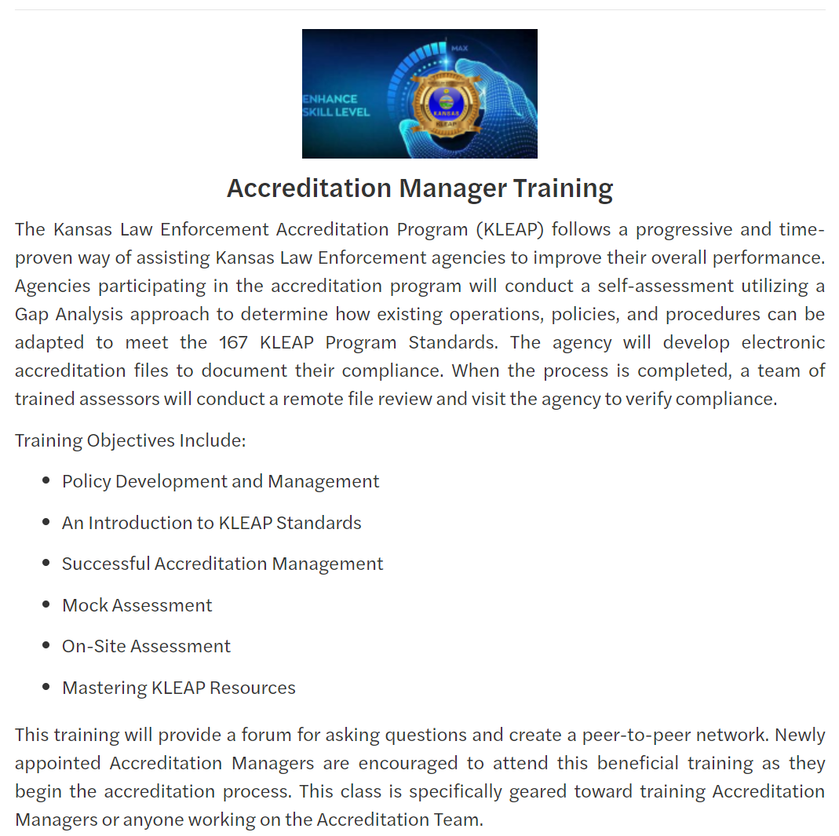
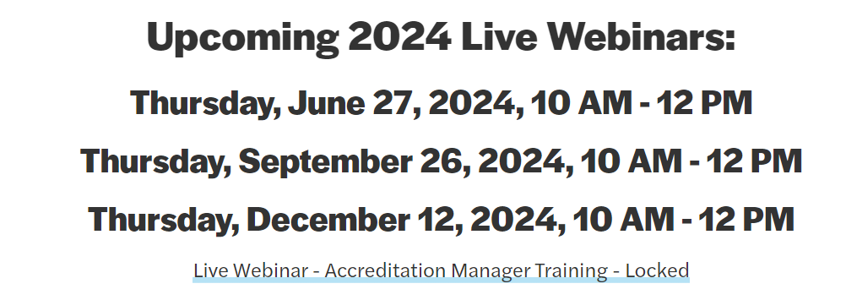
Program Updates
Training Update:

Slide 8
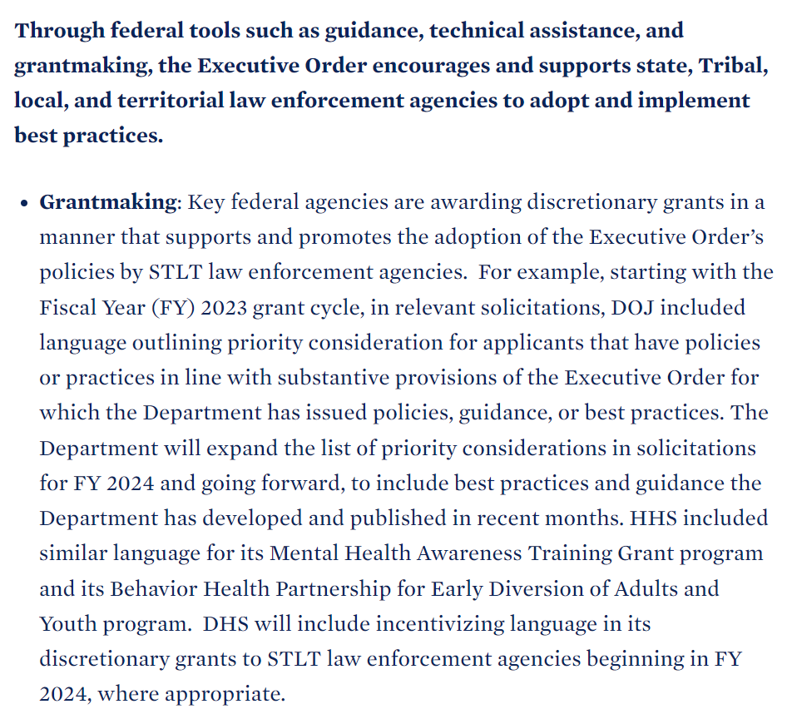
Program Updates
KLEAP Program Changes:
2nd Edition Standards Manual:
Approved August 22, 2024
Will be released January 1, 2025
Standards revised or added for compliance with Executive Order 14074.
Kansas Law Enforcement Accreditation

Slide 9
Program Updates
KLEAP Program Changes:
Standards revised or added for compliance with K.S.A.’s that require written directives.
K.S.A. 22-4620
K.S.A. 22-4610
K.S.A. 22-2307
K.S.A. 22-4621
K.S.A. 22-2310
K.S.A. 22-4619
Kansas Law Enforcement Accreditation

Slide 10
Program Updates
KLEAP Program Changes:
December 2024 LIVE Webinar
Transition Period
Crosswalk 1st Edition to 2nd Edition
Enhanced Tracker
Standard Tags
Initial Accreditation changed to 3-year self assessment period
Annual file review instead of reports
Kansas Law Enforcement Accreditation

