Slide 1
Meeting 12-05-2024

Slide 2
Agenda – Action Items
If your agency Chief Law Enforcement Executive has changed:
A new Participation Agreement is required.
A Bridging document may be needed for your agency’s policies and procedures.
Kansas Law Enforcement Accreditation

Slide 3
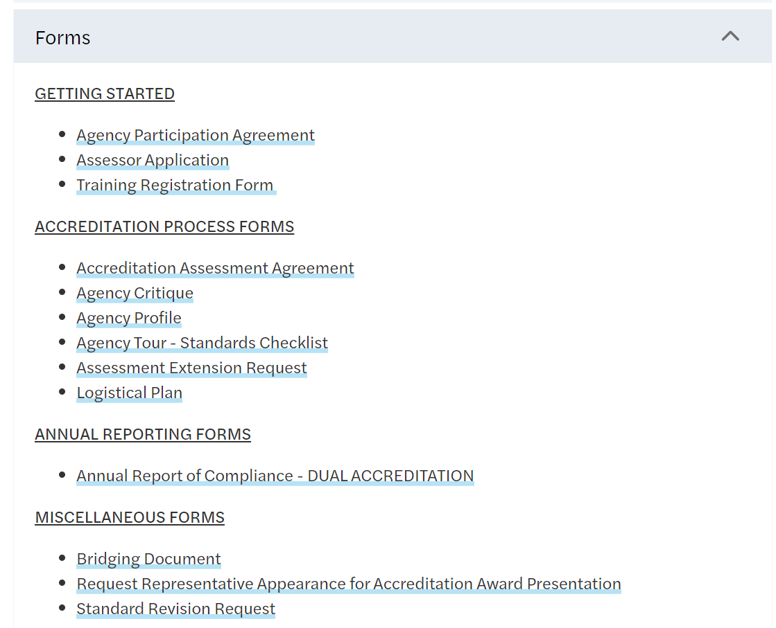
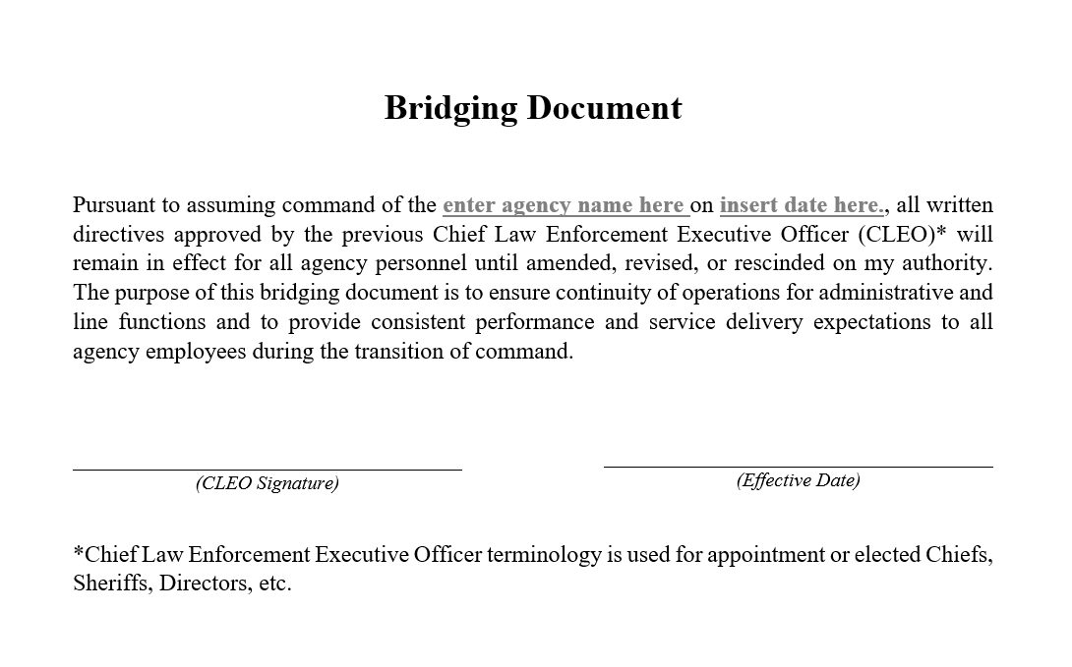
Agenda – Action Items
A Bridging Document is available on the KLEAP Website in the forms section.
Kansas Law Enforcement Accreditation

Slide 4
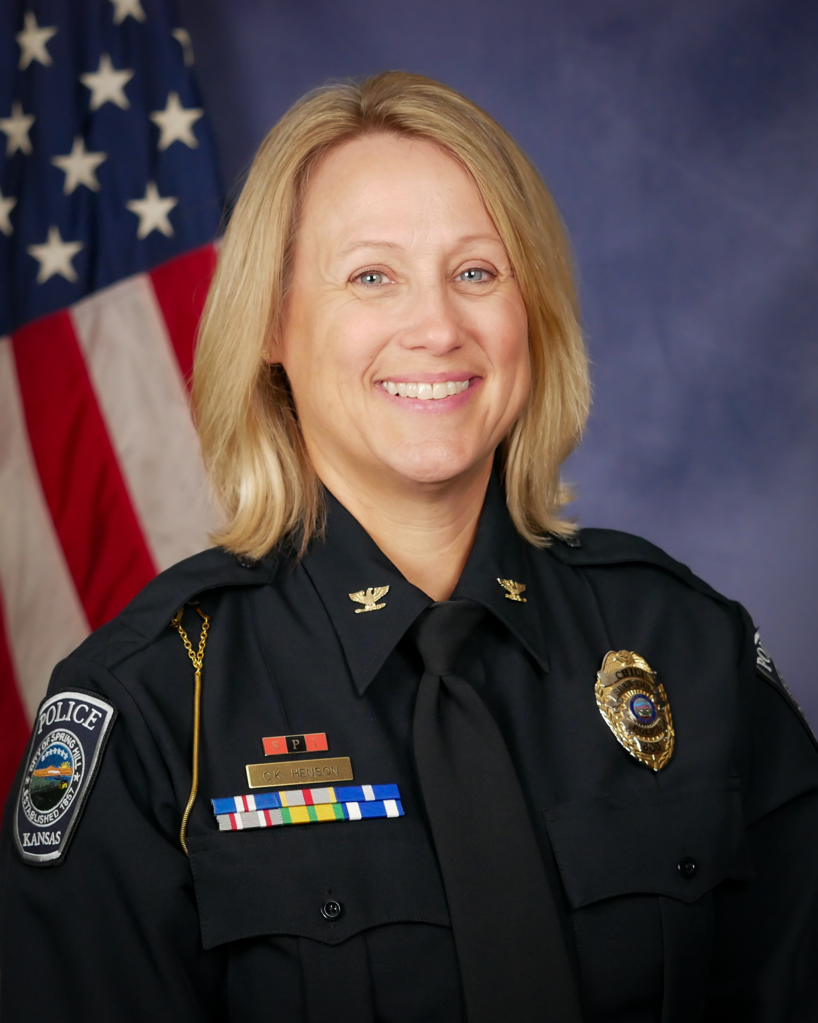
Agenda – Action Items
Introduction – New KAC Member – Chief Cindy Henson, Spring Hill PD
Member At-Large
Biography -----
Chief Henson was hired to lead the Spring Hill Police Department on April 8, 2019. Her experience includes 27 years with the Overland Park Police Department. She retired as a Major overseeing the patrol division, the largest division of the department. During her tenure she worked as a patrol officer, school resource officer, community police officer, bike patrol officer, and hostage negotiator. As a Sergeant, she led narcotic detectives, community officers, and patrol officers. She also worked within professional standards as an inspector. As a Captain, she was a Watch Commander of evening shift, and oversaw personnel and training. She holds a Bachelor of Arts degree in Sociology and is a dean’s list graduate of the Southern Police Institute Police Executive Command School, located at the University of Louisville. She has also attended several leadership courses which include Northwestern Supervisory Course, Leadership Academy, and IACP Leadership of Police Organizations.
Chief Cindy Henson
Spring Hill Police Dept.
Kansas Law Enforcement Accreditation

Slide 5
Agenda – Action Items
NEW AGENCIES – since last meeting.
Prairie Village Police Department: 09-24-2024 [2nd Edition]
Norton Police Department: 09-26-2024 [2nd Edition]
Kansas Law Enforcement Accreditation

Slide 6
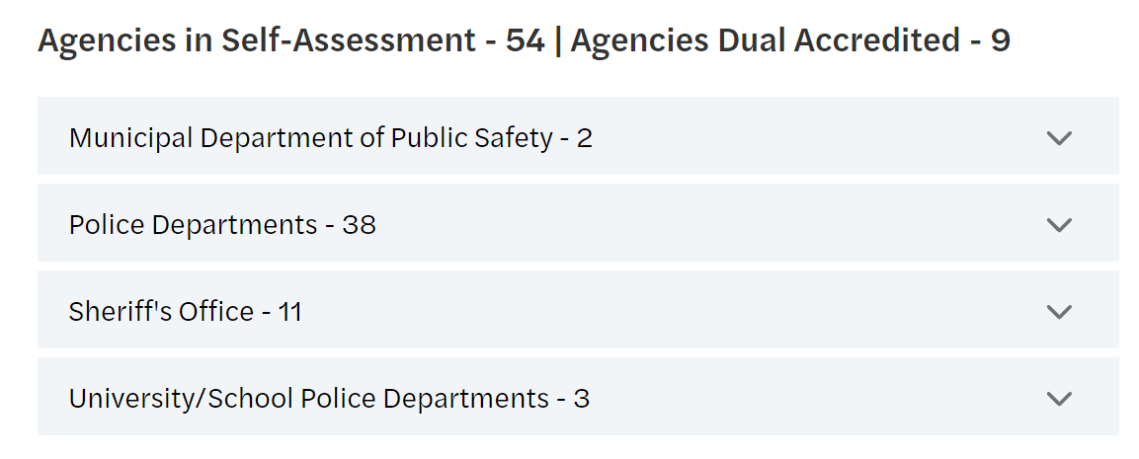
Program Updates
Agency Status:
63 Agencies currently participating.
Kansas Law Enforcement Accreditation

Slide 7
Program Updates
38 Prospective Agencies:
Bonner Springs Police Department
Chase County Sheriff’s Office
Cherokee County Sheriff’s Office
Decator County Sheriff’s Office
Ellsworth County Sheriff’s Office
Ellsworth Police Department
Finney County Sheriff’s Office
Frontenac Police Department
Garden City Police Department
Gardner Police Department
Graham County Sheriff’s Office
Gray County Sheriff’s Office
Haven Police Department
Haysville Police Department
Horton Police Department
Humboldt Police Department
Independence Police Department
Jackson County Sheriff’s Office
Junction City Police Department
Kansas City KS Public Schools PD
Kearney County Sheriff’s Office
Lenexa Police Department
Louisburg Police Department
Miami County Sheriff’s Office
Minneapolis Police Department
Montgomery County Sheriff’s Office
Morton County Sheriff’s Office
Park City Police Department
Rice County Sheriff’s Office
Roeland Park Police Department
Rose Hill Police Department
Russell Police Department
Sherman County Sheriff’s Office
Stevens County Sheriff’s Office
Wathena Police Department
Wichita State University Police Dept.
Winfield Police Department
Woodson County Sheriff’s Office
Kansas Law Enforcement Accreditation

Slide 8
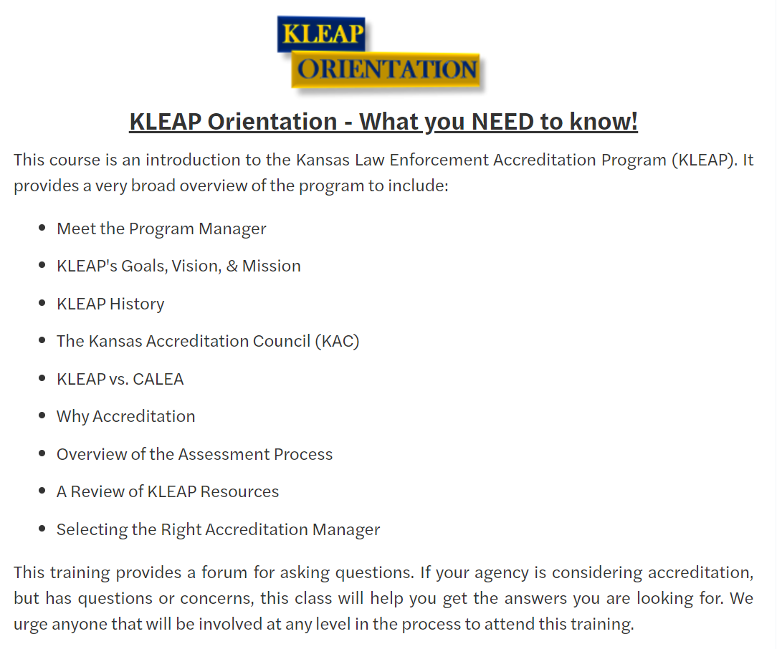
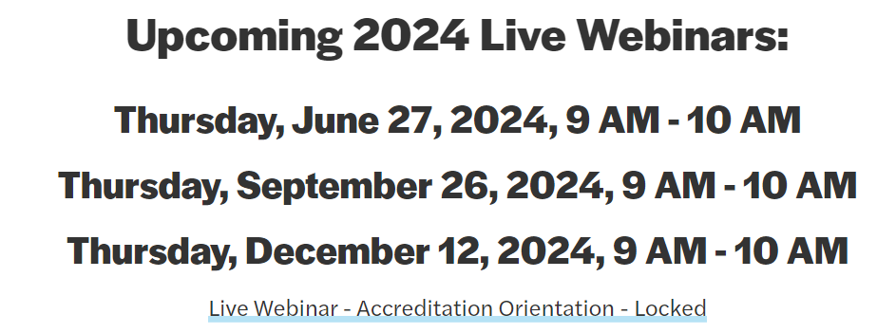
Program Updates
Training Update:

Slide 9
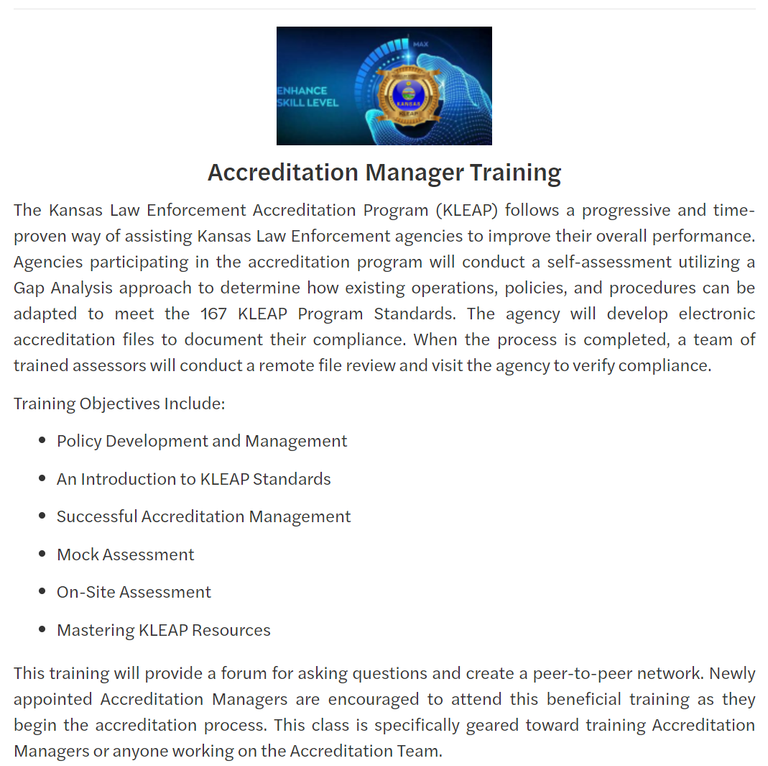
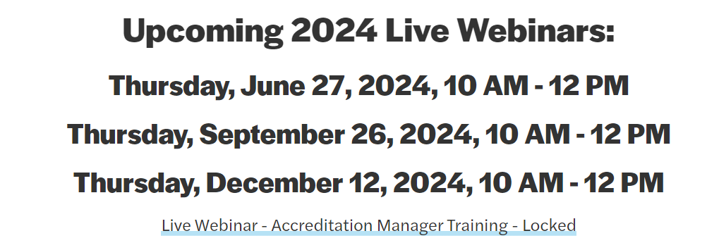
Program Updates
Training Update:

Slide 10
Program Updates
Training Update:
Training Classes:
Accreditation Management Made Easy
Accreditation Manager Hands-On Training
Learning the Flow for File Building
Easy Analysis & Data collection Revealed
Secrets of Policy Writing & Proof Collection
A Road Map to a Successful Assessment
On-Site Assessment – A Lead Assessors Prospective
Mastering PowerDMS/CIMRS
Assessor Refresher Training – Agency File Review
KLEAP File Building Clinic
Networking Night – Pizza, Game Show Competition, & Swag Bag Exchange
More Information

Slide 11
Program Updates
KLEAP Program Changes:
2nd Edition Standards Manual:
Approved August 22, 2024
Will be released January 1, 2025 – All agencies signing a Participation Agreement after 09-15-2024 will be required to utilize the 2nd Edition Manual.
All Agencies working on initial accreditation under the 1st Edition will be required to change over to 2nd Edition upon starting their 1st Reaccreditation process.
Kansas Law Enforcement Accreditation

Slide 12
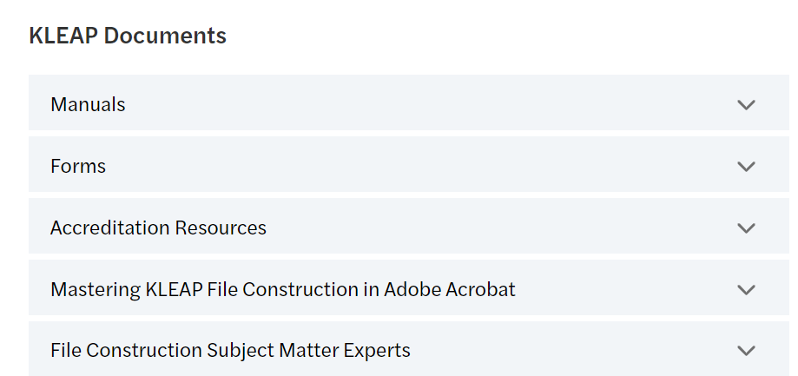
Program Updates
KLEAP Program Changes:
Updated:
Agencies shall NOT follow instructions provided within Addendum D of the 1st Edition Standards Manual but shall refer to the Mastering KLEAP File Construction provided on the KLEAP Website.
Website Updates:
UPDATED
NEW
UPDATED

Slide 13
Program Updates
KLEAP Program Changes:
Updated:
Agencies shall NOT follow instructions provided within Addendum D of the 1st Edition Standards Manual but shall refer to the Mastering KLEAP File Construction provided on the KLEAP Website.
Website Updates:
UPDATED
NEW
UPDATED

Slide 14
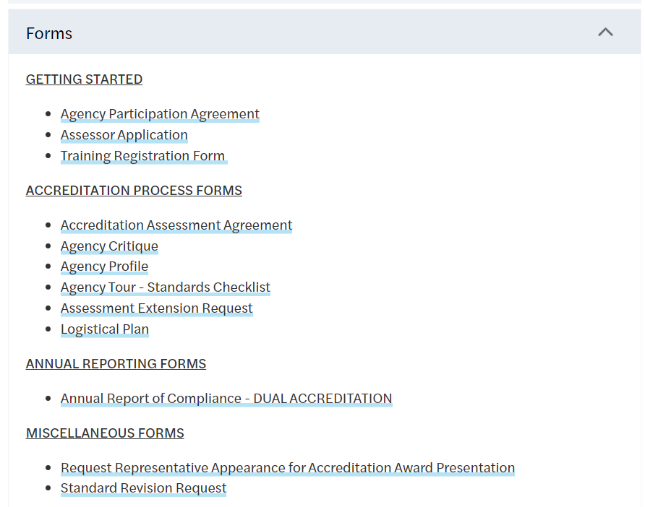
Program Updates
KLEAP Program Changes:
NEW for Reaccreditation:
An Annual Report of Compliance for KLEAP accredited agencies is no longer required, instead agencies will undergo an annual remote file review by the Program Director, or designee.
Dual Accredited agencies will still be required to submit a copy of their CALEA Annual Report.
Website Updates:
Kansas Law Enforcement Accreditation

Slide 15
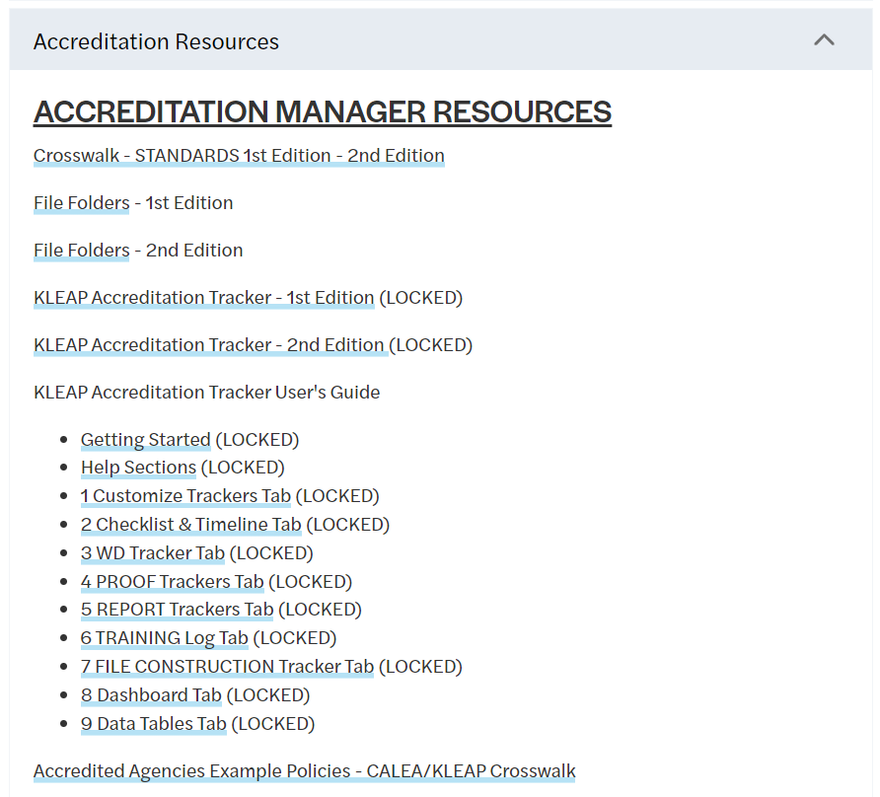
Program Updates
KLEAP Program Changes:
Website Updates:
New:
Provides a detailed overview of the changes made to standards from 1st Edition to the 2nd Edition.
Agencies currently undergoing Initial Accreditation in the 1st Edition will NOT need to convert to the 2nd Edition until they start their 1st Reaccreditation.
NEW
Kansas Law Enforcement Accreditation

Slide 16
Program Updates
KLEAP Program Changes:
Website Updates:
New:
File Folders for 2nd Edition have been added to the website.
NEW
Kansas Law Enforcement Accreditation

Slide 17
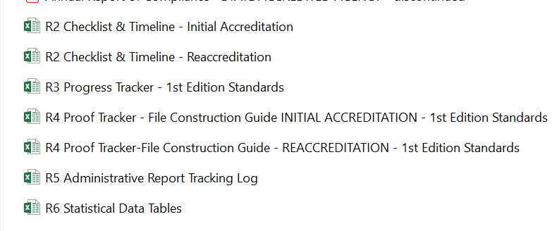
Program Updates
KLEAP Program Changes:
New:
Individual Trackers have been removed and replaced with a NEW robust tracker.
Website Updates:
NEW
Thank You Ashley Behney, Accreditation Manager Marshall County Sheriff’s Office
Kansas Law Enforcement Accreditation

Slide 18
Program Updates
KLEAP Program Changes:
Website Updates:
New:
A robust 4-year tracker for Reaccreditation has been established for the 2nd Edition.
User’s Guides have been established for the new KLEAP Accreditation Trackers.
Training on the NEW KLEAP Accreditation Tracker is coming soon!
NEW
NEW
Kansas Law Enforcement Accreditation

Slide 19
Program Updates
KLEAP Important Dates:
Program Director - Vacation:
Kansas Law Enforcement Accreditation

